Slide 1
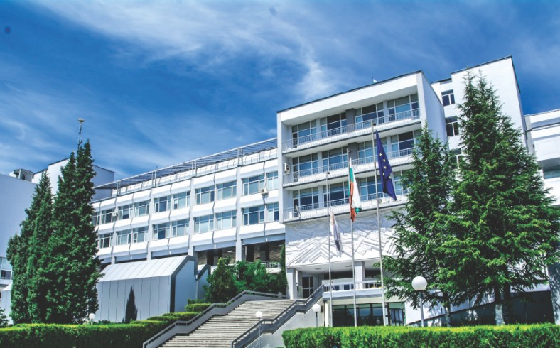
INVITATION
DEAR COLLEAGUES,
On behalf of the Program Council and the Organizing Committee, we are pleased to invite you to take part in the Jubilee Scientific Conference “Challenges for Contemporary Economic Science - Sustainability and Digitalization."
The conference is organized by the Faculty of Economics under the patronage of the Rector of the South-West University "Neofit Rilski“, Prof. Dr. Borislav Yurukov.
Jubilee scientific conference
on the occasion of the 30-year Anniversary of the
Faculty of Economics at
South-West University "Neofit Rilski" - Blagoevgrad
Thematic directions
Risk analysis, risk assessment and management
Insurance
Crisis management, safety and security
Economics and management of tourism
Education and training
Management of financial resources, results and forecasting
Policy, planning and management
Business analysis, models and operational practice
Channels for management and distribution of supply chains in times of crisis
Consumer behavior, consumption, decision making, experience and satisfaction
Competitiveness, sustainability and corporate social responsibility
Digital transformations in tourism
Smart cities, mobile technologies, machine learning, database analysis
Digital economies
Marketing, digital marketing communications
Human resource management and strategic leadership development
Innovation, creativity and change management
“Challenges for Contemporary Economic Science - Sustainability and Digitalization”
Economic, social and health effects
of the pandemic in the modern world
Faculty of Law, Administration and Economics 7-10 University Street
May 20-21, 2021; Wroclaw, Poland Online Conference (Microsoft Teams)
Important deadlines
30.09.2021 Cut-off date for submitting applications in Bulgarian or English through the conference e-mail address: conference_fe@swu.bg (Download - Application for participation)
20.10.2021 Cut-off date for submission of the papers
Location
The conference will be held at Bachinovo University Center of the South-West University “Neofit Rilski” in Blagoevgrad and online via the platform BigBlueButton – https://bbb.swu.bg/b
Publication opportunities
The conference will be included in the Register of Scientific Activity at the Ministry of Education and Science.
The accepted conference papers shell be published in an electronic version in the on-line conference proceedings.
Selected papers, after double-blind reviews, shall be published in English in the journals:
"Economics and Management" (http://em.swu.bg),
“Entrepreneurship” (http://ep.swu.bg),
“Economics and Law” (http://el.swu.bg),
indexed in the databases ERIHPLUS,, American Economy Association,, RePEc,, Central and Eastern Online Library, SOCIONET, GOOGLE SCHOLAR,, DRJI,, Bayerische State Library,, MIAR etc.
Note: The English translation of the papers is authors’ responsibility.
November 11 -12, 2021
Blagoevgrad

Slide 2
Organizer
Requirements for formatting of the papers
Faculty of Economics, South-West University "Neofit Rilski" Blagoevgrad
The maximum paper volume is 15 pages, incl. tables, figures (graphs and diagrams) and bibliography.
Only original, unpublished in other periodicals or other journals reports are allowed to participate.
Each author (individually or in co-authorship) can participate with one paper and one co-authored paper
The papers can be prepared and presented in Bulgarian or in English. Those participants who want their papers to be published in the faculty journals must translate them into English.
The papers, prepared in accordance with the requirements, will be published in a collection with an ISBN.
The time for presenting and discussing of a paper is 15 minutes.
Presentation of the conference papers should be in Power Point
The papers should be done according to the formatting requirements included in the template: (DOWNLOAD - Template)
Participation fee
The participation fee for Bulgarian participants is 120 BGN (one hundred and twenty BGN) and should be transferred to the following account:
Bank: Municipal Bank AD IBAN: BG62SOMB91303160613000 BIC: SOMBBGSF
Grounds: Faculty of Economics – Jubilees Conference (The participant surname)
The fee for foreign participants is 60 euros (sixty euros) and should be transferred to the following account:
Bank: Municipal Bank AD
IBAN: BG97SOMB91303460613000 BIC: SOMBBGSF
Grounds: Faculty of Economics – Jubilees Conference (The participant surname)
Note: The conference fee have to be paid up to 10 days before the start of the conference upon receiving of a paper approval e-mail massage.
Discussion forum
A round-table discussion will be held during the conference on the topic: "Business, Institutions and Education: Challenges and Perspectives"
Program council
Prof. Dr. Preslav Dimitrov - Chairman of the Program Council, Dean of the Faculty of Economics and Head of the Department of Tourism at SWU "N. Rilski ”-Blagoevgrad
Assoc. Prof. Dr. Vyara Kyurova - Deputy Dean of the Faculty of Economics at SWU "N. Rilski ”-Blagoevgrad
Prof. Dr. Maria Stankova - Deputy Dean of the Faculty of Economics at SWU "N. Rilski ”-Blagoevgrad
Assoc. Prof. Dr. Vladimir Tsenkov - Scientific Secretary of the Faculty of Economics at SWU "N. Rilski ”-Blagoevgrad
Prof. Dr. Maria Kicheva-Kirova - Head of the Department of Economics at the Faculty of Economics at SWU "N. Rilski ”-Blagoevgrad
Prof. Dr. Milena Filipova - Head of the Department of Management and Marketing at the Faculty of Economics at SWU "N. Rilski ”-Blagoevgrad
Assoc. Prof. Dr. Elena Stavrova - Head of the Department of Finance and Accounting at the Faculty of Economics at SWU "N. Rilski ”-Blagoevgrad
Organising Committee
Prof. Dr. Preslav Dimitrov - Dean of the Faculty of Economics and Head of the Department of Tourism at SWU "N. Rilski ”-Blagoevgrad
Prof. Dr. Maria Stankova - Deputy Dean of the Faculty of Economics at SWU "N. Rilski ”-Blagoevgrad
Assoc. Prof. Dr. Elena Stavrova - Head of the Department of Finance and Accounting at the Faculty of Economics at SWU "N. Rilski ”-Blagoevgrad
Ch. Assistant Professor Dr. Dinka Zlateva- Department of Management and Marketing, Faculty of Economics at SWU "N. Rilski" - Blagoevgrad
Ch. Assistant Professor Dr. Ruska Bozhkova- Department of Tourism, Faculty of Economics at SWU "N. Rilski" - Blagoevgrad
Ch. Assistant Professor Dr. Irina Atanasova- Department of Economics, Faculty of Economics at SWU "N. Rilski" - Blagoevgrad
Assistant Professor Dr. Kalinа Durova - Department of Finance and Accounting, Faculty of Economics at SWU "N. Rilski" - Blagoevgrad
Organization associates
Miglena Vasileva - Secretary of the Faculty of Economics at SWU "Neofit Rilski" - Blagoevgrad
Milena Donina - Department Secretary
Natasha Boyanova- Department Secretary
Lachezar Gogov - Technical Assistant

